Slide 1
Unsupervised Machine Learning (ML) and Clustering Algorithms
Felix Gonzalez, P.E.
felix.gonzalez@gmail.com
fgonzaleumbc/DATA601.com

Slide 2
Unsupervised ML and Clustering Algorithms
Unsupervised ML and clustering algorithms find patterns within a dataset and creates groups or clusters using these patterns
Clusters can then be analyzed individually (e.g., statistics, ranking, behaviors, etc.) to extract insights
Main types of clustering algorithms:
Centroid based
Density based
Notes:
Clustering algorithms characteristics:
Centroid based algorithms require user to specify number of clusters to divide the data into. The algorithm will assign each record to a cluster which has a centroid and the resulting clusters are linearly separable.
Density based algorithms require the user to specify at a minimum two parameters, (1) minimum samples in a cluster and (2) Epsilon/EPS parameter. The EPS parameter is a distance metric of how far a data point is to its neighbors. If a data point or record does not meet both of the parameters, the data point is considered noise or an outlier.
Exercise Notebook uses clustering algorithms to group data from Disney Shows data or Unidentified Flying Objects reports.

Slide 3
Group/Clusters
How many features are we plotting?
How many groups do you see?
Which distance metric did you use to create groups and thoughts on why?
Thoughts on optimal number of clusters?
Do you see any outliers?

Slide 4
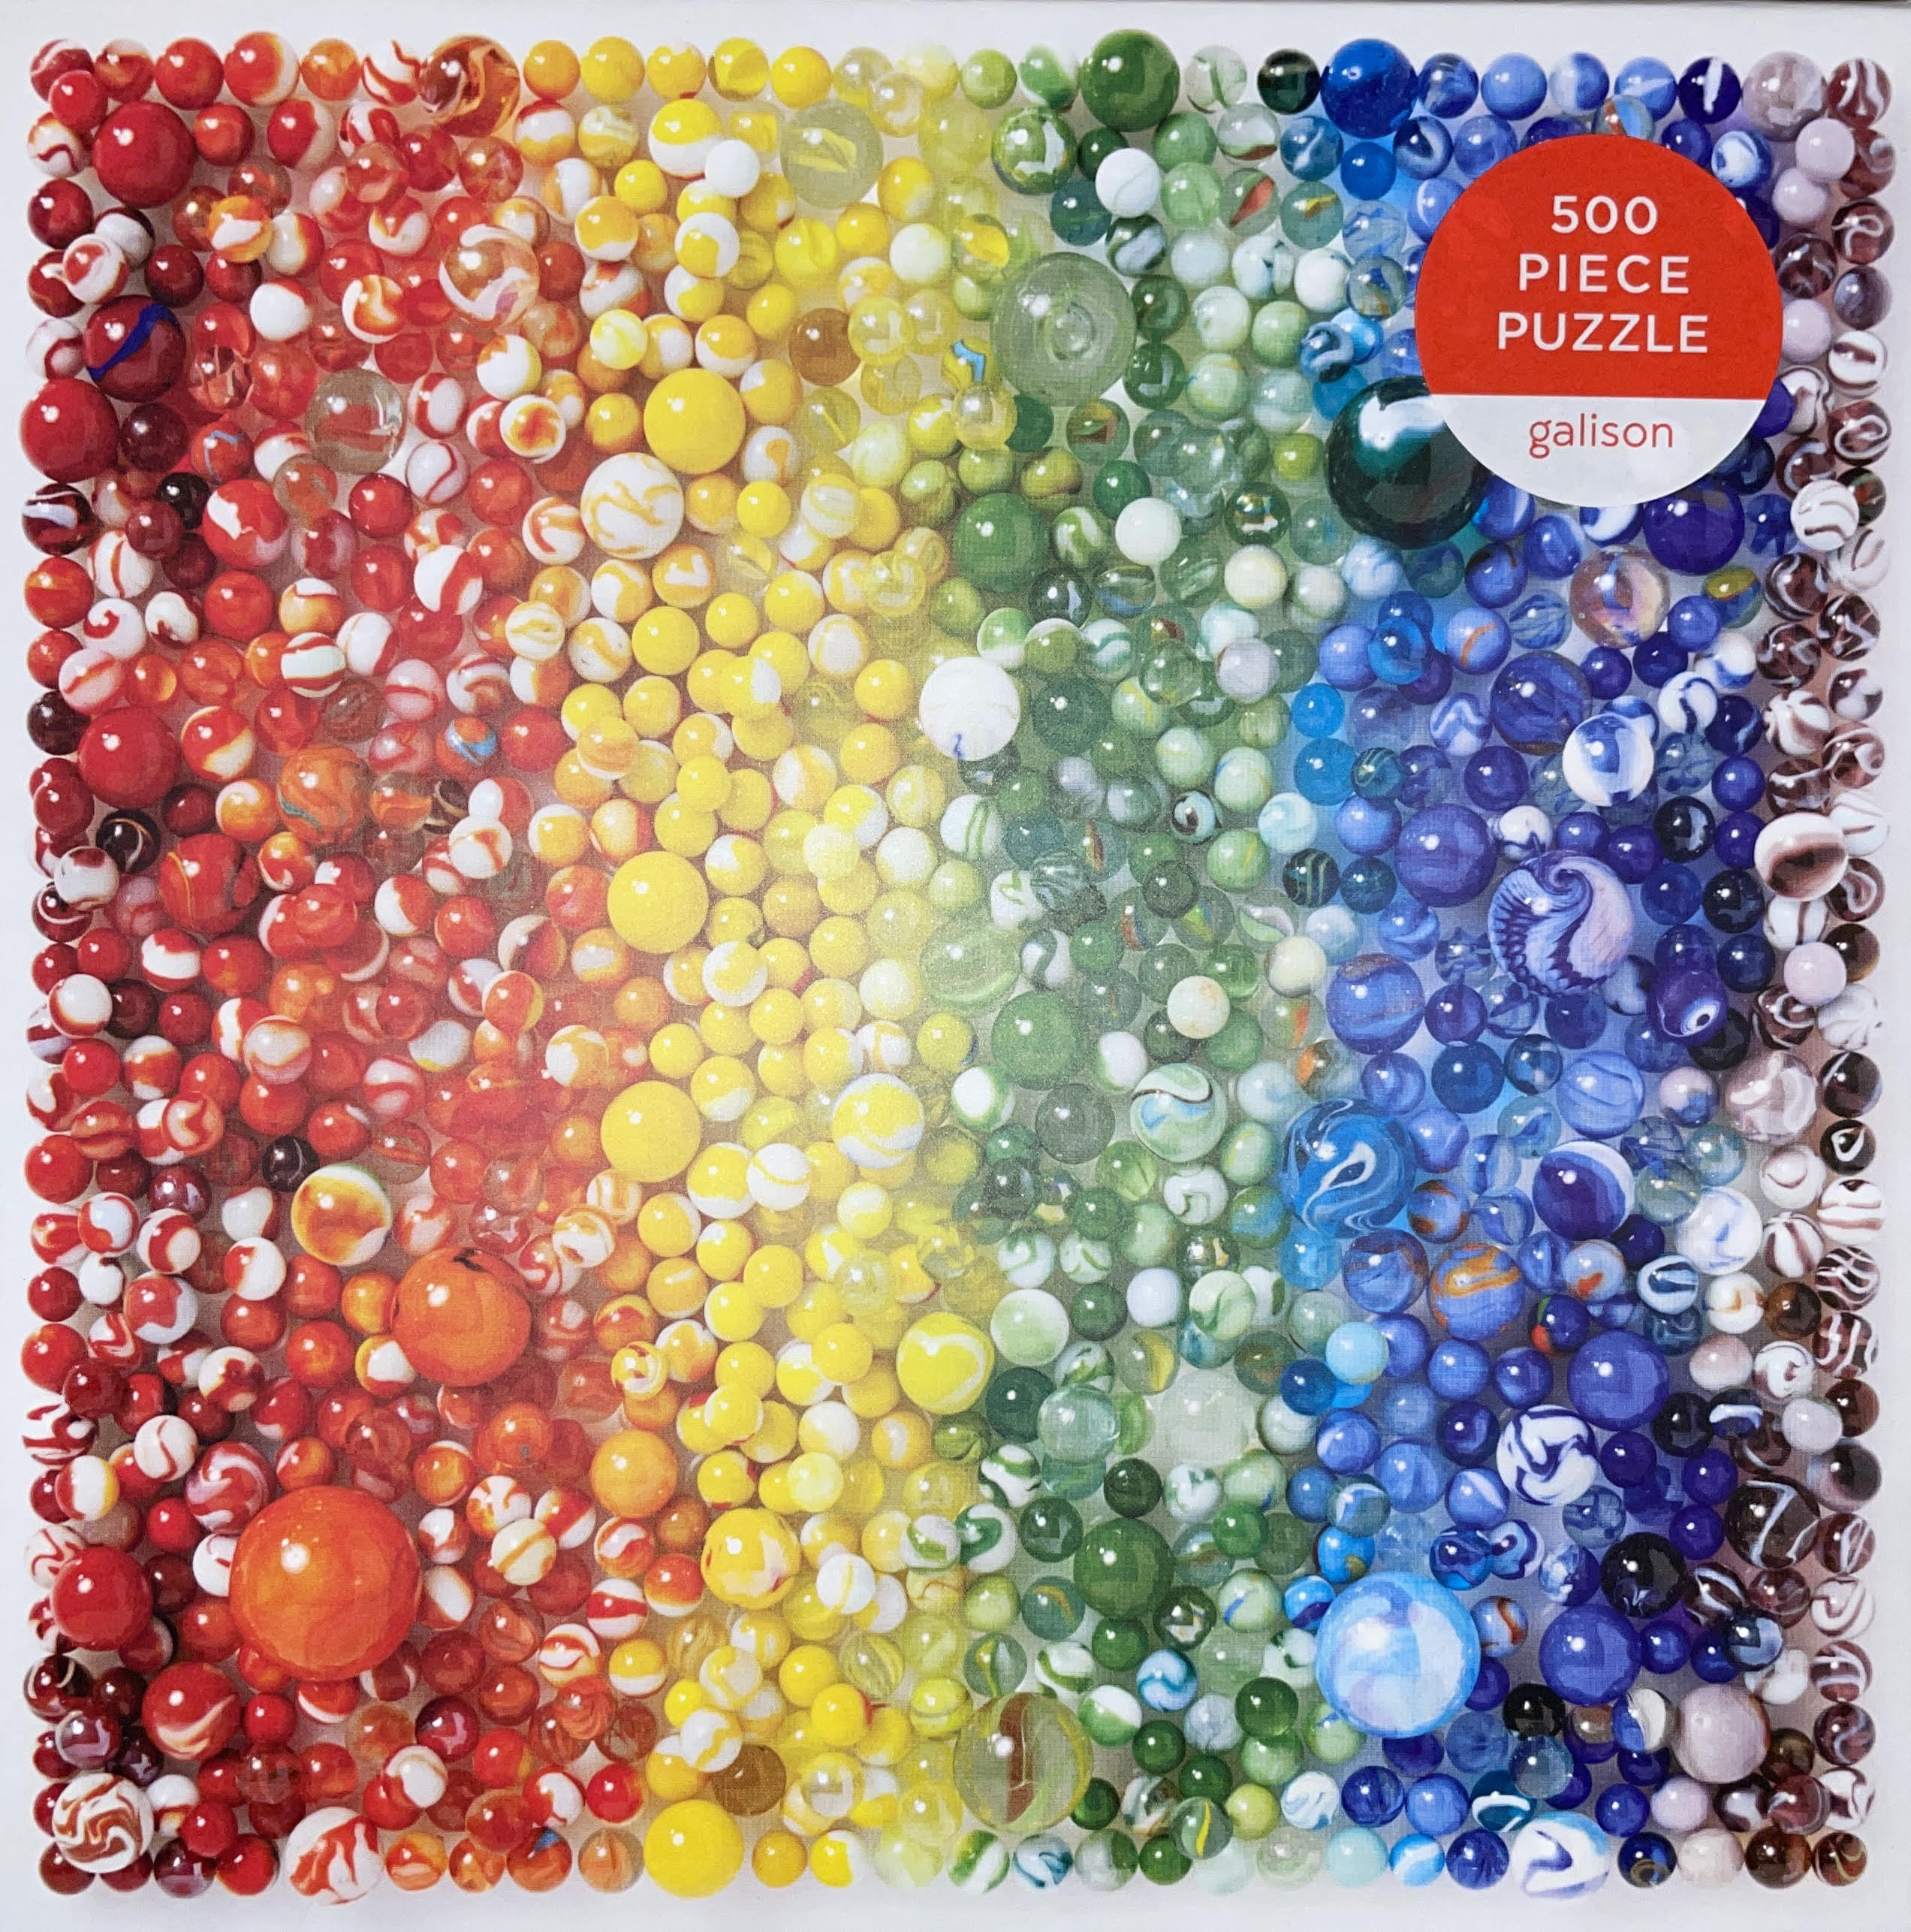
Unsupervised ML: Puzzle Example
What do we do when we start a puzzle?
What data features do we use?
Notes:
Unsupervised ML attempts to simulate that logic of grouping.

Slide 5
Sample Machine Readable Puzzle Data
Piece | Corner | Border | Border Sides | Slot Sides | Knob Sides | Primary Color
1 | Yes | Yes | 2 | 2 | 0 | Red
2 | No | No | 0 | 4 | 0 | Yellow
3 | No | Yes | 1 | 3 | 0 | Green
4 | No | Yes | 1 | 2 | 1 | Yellow
5 | No | No | 0 | 2 | 2 | Blue
6 | No | No | 0 | 1 | 3 | Red
7 | Yes | Yes | 2 | 1 | 1 | Purple
8 | No | No | 0 | 3 | 1 | Purple
9 | No | No | 0 | 2 | 2 | Blue
10 | No | Yes | 1 | 1 | 2 | Red
With Data Transformation and Derived Features
Piece | Corner | Border | Border Sides | Slot Sides | Knob Sides | Primary Color | Red | Yellow | Green | Blue | Purple | Total Sides
1 | Yes | Yes | 2 | 2 | 0 | Red | 1 |  |  |  |  | 4
2 | No | No | 0 | 4 | 0 | Yellow |  | 1 |  |  |  | 4
3 | No | Yes | 1 | 3 | 0 | Green |  |  | 1 |  |  | 4
4 | No | Yes | 1 | 2 | 1 | Yellow |  | 1 |  |  |  | 4
5 | No | No | 0 | 2 | 2 | Blue |  |  |  | 1 |  | 4
6 | No | No | 0 | 1 | 3 | Red | 1 |  |  |  |  | 4
7 | Yes | Yes | 2 | 1 | 1 | Purple |  |  |  |  | 1 | 4
8 | No | No | 0 | 3 | 1 | Purple |  |  |  |  | 1 | 4
9 | No | No | 0 | 2 | 2 | Blue |  |  |  | 1 |  | 4
10 | No | Yes | 1 | 1 | 2 | Red | 1 |  |  |  |  | 4
Notes:
Derived feature “Total Sides” can be used for verification purposes. Any record that has something different than 4 has an error. Could also create a feature for checking colors if we know that only Red/Yellow/Green/Purple are the only colors then anything different most probably needs to be verified as it could be an error. Other error checking routines could include checking that the corners only have 4, slot sides and knob sides cannot be higher than 4, border sides cannot be more than 2.
Other potential features could include orientation of border sides descriptions, RGB color numbers, primary and secondary colors (could include orientation given the way that the puzzle is oriented where one color may be on the right another on the left) and others.

Slide 6
Example: Customer Data
In customer segmentation the goal is to group customers for targeted actions (e.g., promotions)
Customer data may include:
Age
Gender
Annual income
Spending habit
Family size
Profession
Work experience
The clustering algorithm creates groups based on the features. Groups statistics can then be analyzed for patterns and targeted actions.
Similar approach can be used for text data, but text data is vectorized where words are mapped to vectors (i.e., convert to numerical form).
Notes:
Clustering or grouping could be performed in various ways. Using MS Excel starts to show limitations. Although MS Excel ha various powerful analytic capabilities in this case it is very difficult to perform via filter grouping. Tools like Python libraries will allow to use ML Clustering algorithms to create groups and analyze the grouped data afterwards.

Slide 7
Python Clustering Example: Text Datasets
Dataset 1: Disney Plus Movies and Shows
https://www.kaggle.com/datasets/shivamb/disney-movies-and-tv-shows
Dataset 2: Unidentified Flying Object (UFO)
https://www.kaggle.com/datasets/NUFORC/ufo-sightings?select=complete.csv
https://github.com/planetsig/ufo-reports

Slide 8
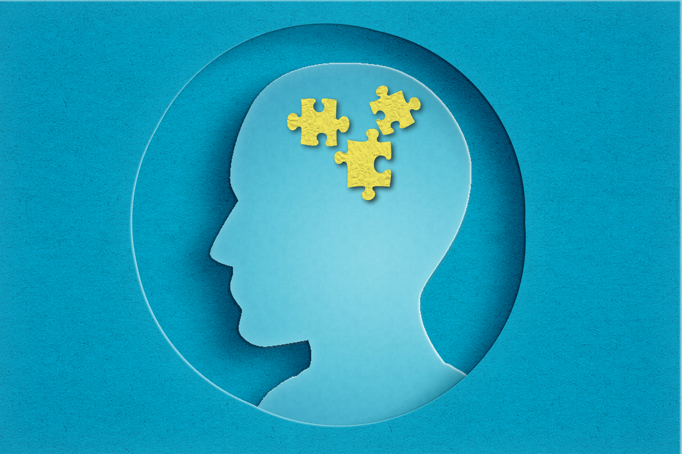
Questions?
Notes:
Marble Puzzle: What things do we do when starting a puzzle?

